Slide 1
Linear Regression

Slide 2
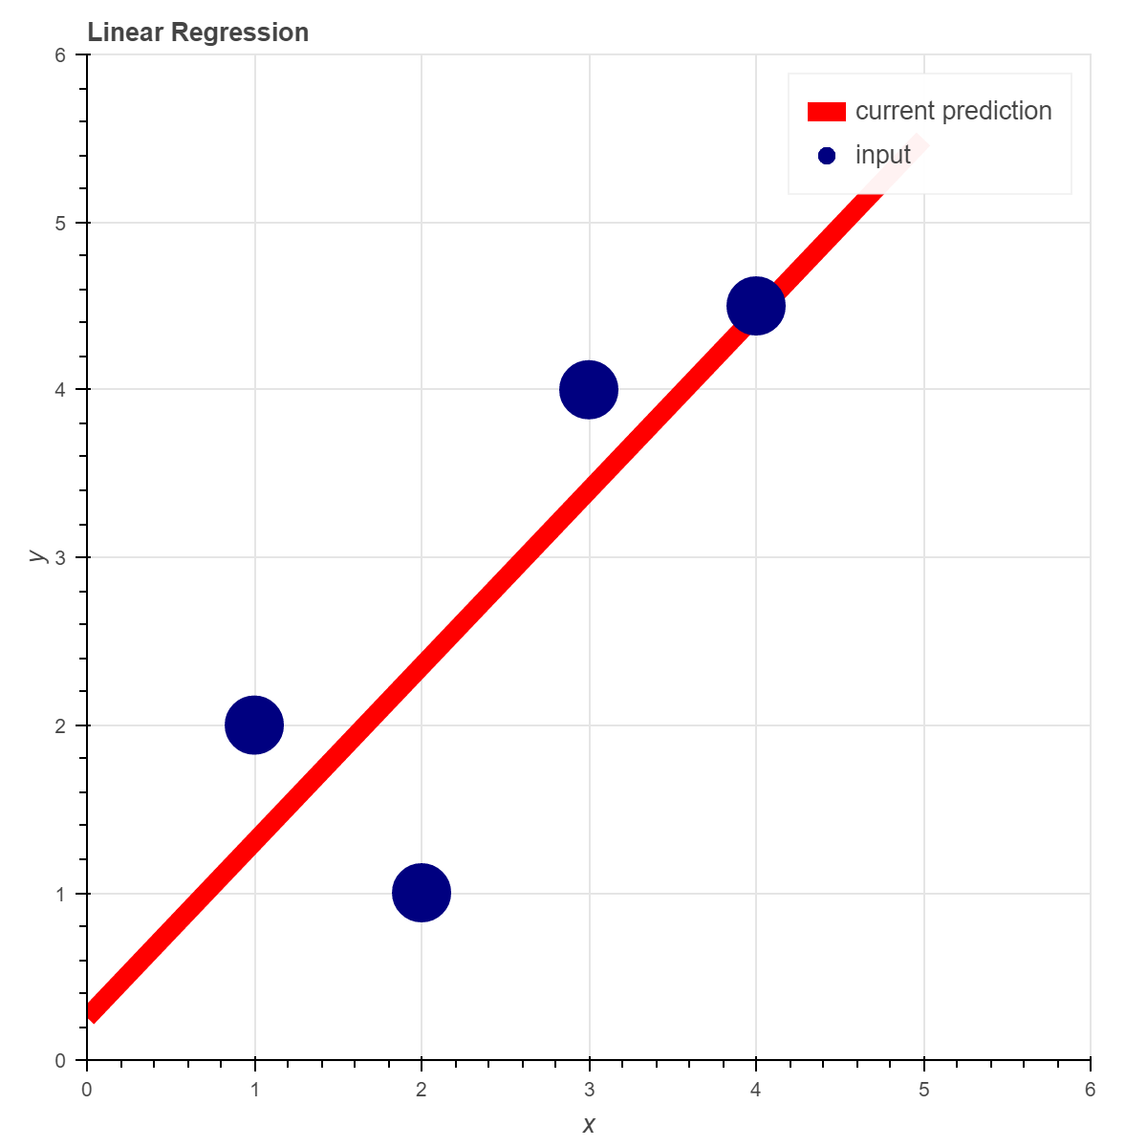
Linear Regression
Linear Regression attempts to model the relationship between a scalar output value (y) and one or more input variables (X)
The function of a line is one model that can be used:
y = mX + b
We would “learn” by adjusting our ‘m’ and ‘b’ variables so that the line best matches the input data.

Slide 3
Linear Regression
Three steps for learning:
Take a guess – Our guess will be defined as a heuristic formula.
Evaluate our best guess – We will define a cost function that will tell us how far away our heuristic is from giving the correct answer(s).
Adjust our best guess – We will use a technique called gradient descent to adjust our heuristic in a manner that will cause our cost function to return the lowest error possible.

Slide 4
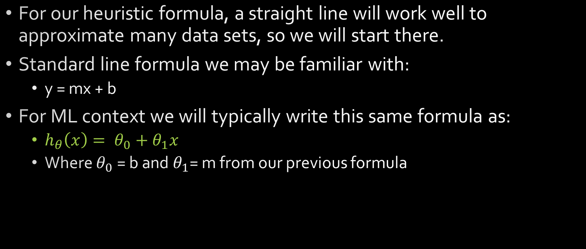
Linear Regression Heuristic
For our heuristic formula, a straight line will work well to approximate many data sets, so we will start there.
Standard line formula we may be familiar with:
y = mx + b
For ML context we will typically write this same formula as:
$h_{θ}\left(x\right)= θ_{0}+θ_{1}x$
Where $θ_{0}$ = b and $θ_{1}$= m from our previous formula

Slide 5
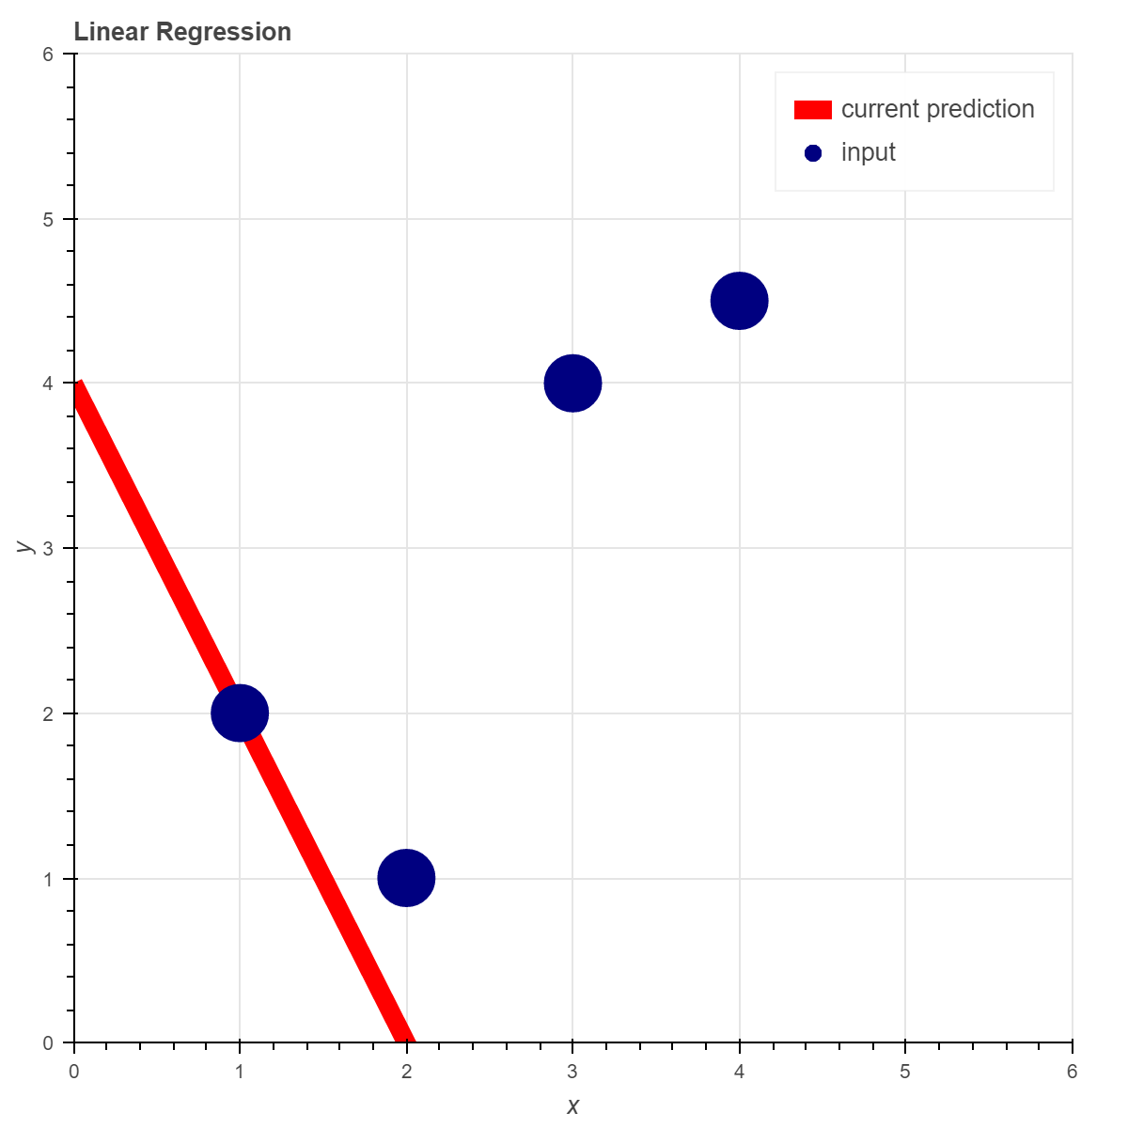
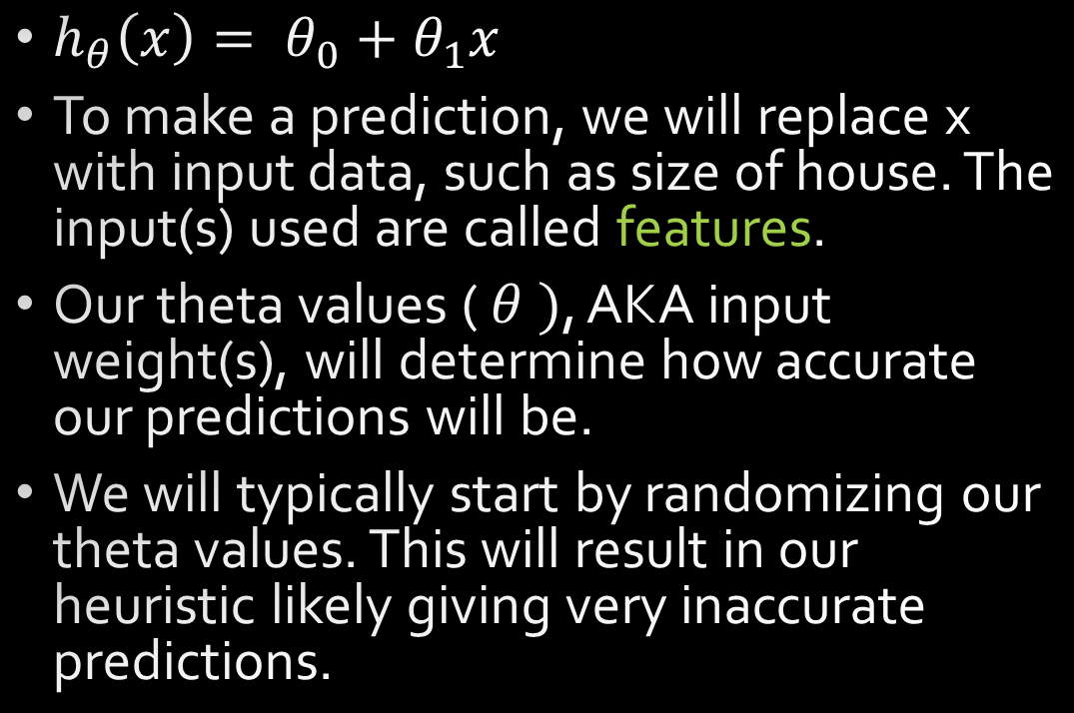
Linear Regression Heuristic
$h_{θ}\left(x\right)= θ_{0}+θ_{1}x$
To make a prediction, we will replace x with input data, such as size of house. The input(s) used are called features.
Our theta values ( $θ )$, AKA input weight(s), will determine how accurate our predictions will be.
We will typically start by randomizing our theta values. This will result in our heuristic likely giving very inaccurate predictions.

Slide 6
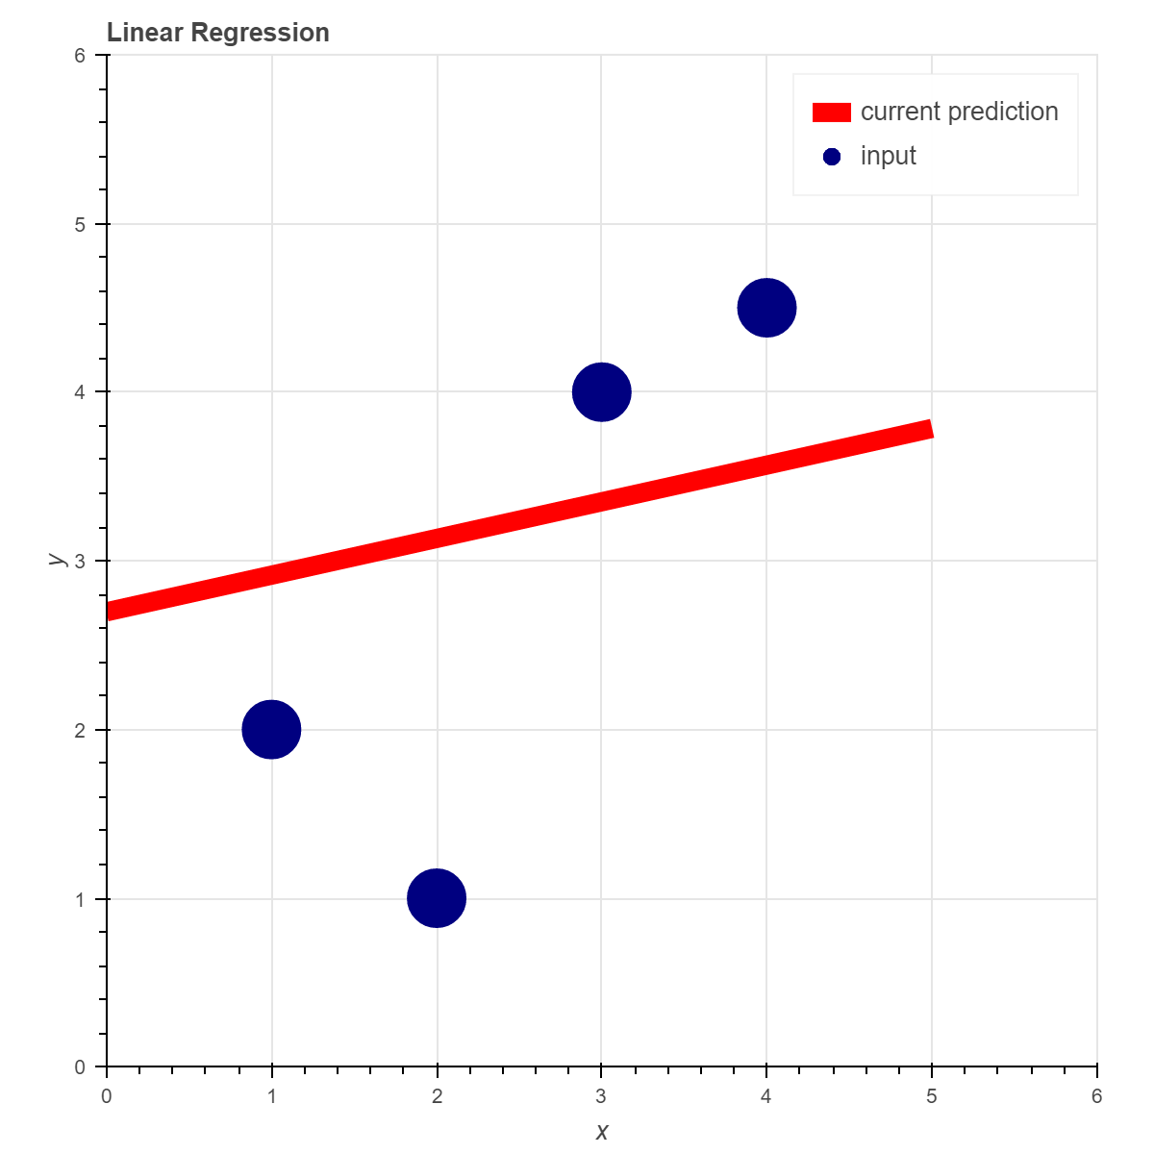
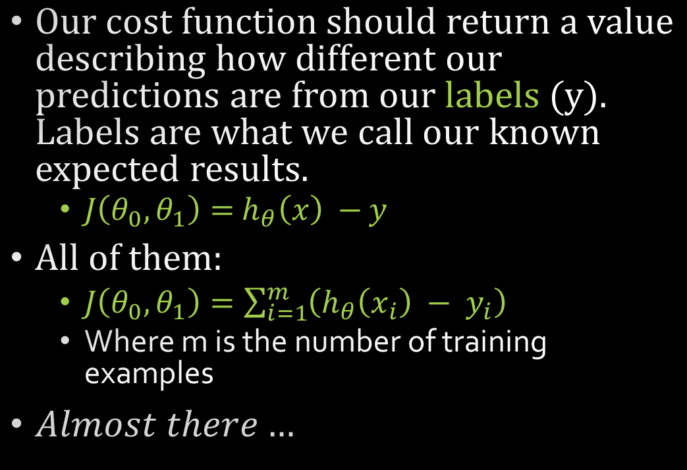


Linear Regression Cost Function
Our cost function should return a value describing how different our predictions are from our labels (y). Labels are what we call our known expected results.
$J\left(θ_{0},θ_{1}\right)=$ $h_{θ}\left(x\right) −$ $y$
All of them:
$J\left(θ_{0},θ_{1}\right)=\sum_{i=1}^{m}{\left(h_{θ}\left(x_{i}\right) − y_{i}\right)}$
Where m is the number of training examples
$Almost there…$
$$h_{θ}(X_{2})$$
$$y_{2}$$

Slide 7
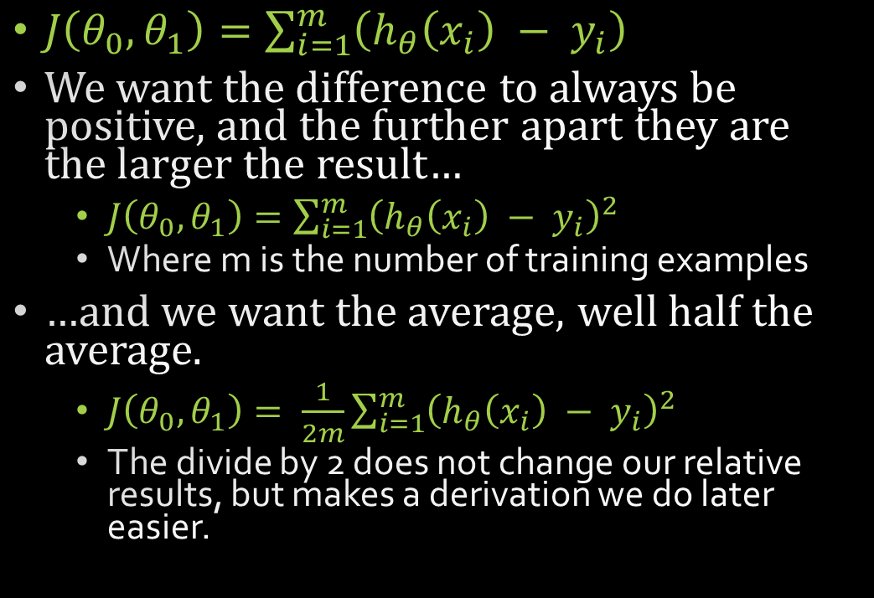
Linear Regression Cost Function
$J\left(θ_{0},θ_{1}\right)=\sum_{i=1}^{m}{\left(h_{θ}\left(x_{i}\right) − y_{i}\right)}$
We want the difference to always be positive, and the further apart they are the larger the result…
$J\left(θ_{0},θ_{1}\right)=\sum_{i=1}^{m}{{\left(h_{θ}\left(x_{i}\right) − y_{i}\right)}^{2}}$
Where m is the number of training examples
…and we want the average, well half the average.
$J\left(θ_{0},θ_{1}\right)= \frac{1}{2m}\sum_{i=1}^{m}{{\left(h_{θ}\left(x_{i}\right) − y_{i}\right)}^{2}}$
The divide by 2 does not change our relative results, but makes a derivation we do later easier.
$$h_{θ}(X_{2})$$
$$y_{2}$$

Slide 8
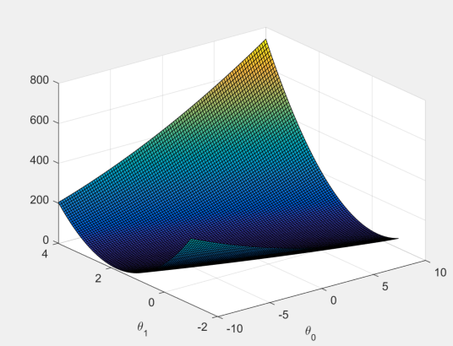
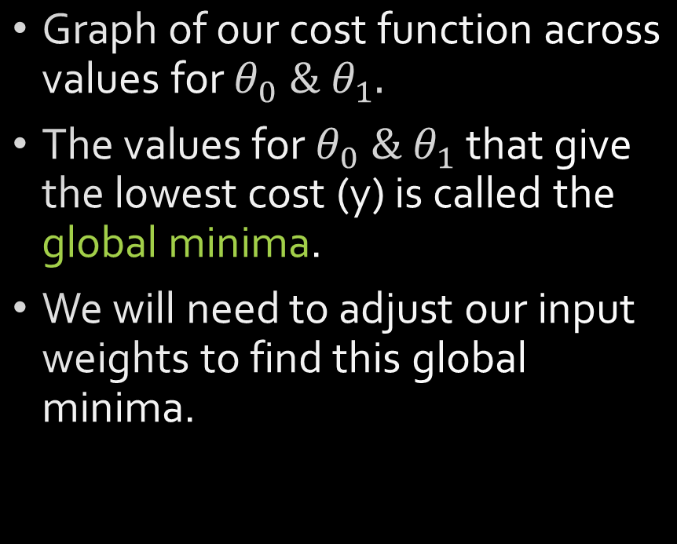
Linear Regression Cost Function
Graph of our cost function across values for $θ_{0} \& θ_{1}.$
The values for $θ_{0} \& θ_{1}$ that give the lowest cost (y) is called the global minima.
We will need to adjust our input weights to find this global minima.
y

Slide 9


Linear Regression- adjusting our guess
We could just set values for our input weights randomly until we find a low cost, but this approach is likely to give poor results and take a very long time to get any sort of good answer.
Each of our input weights, $θ_{0},θ_{1}$, are linear values. If only we knew which direction to adjust them in so as to reduce our cost function result…

Slide 10
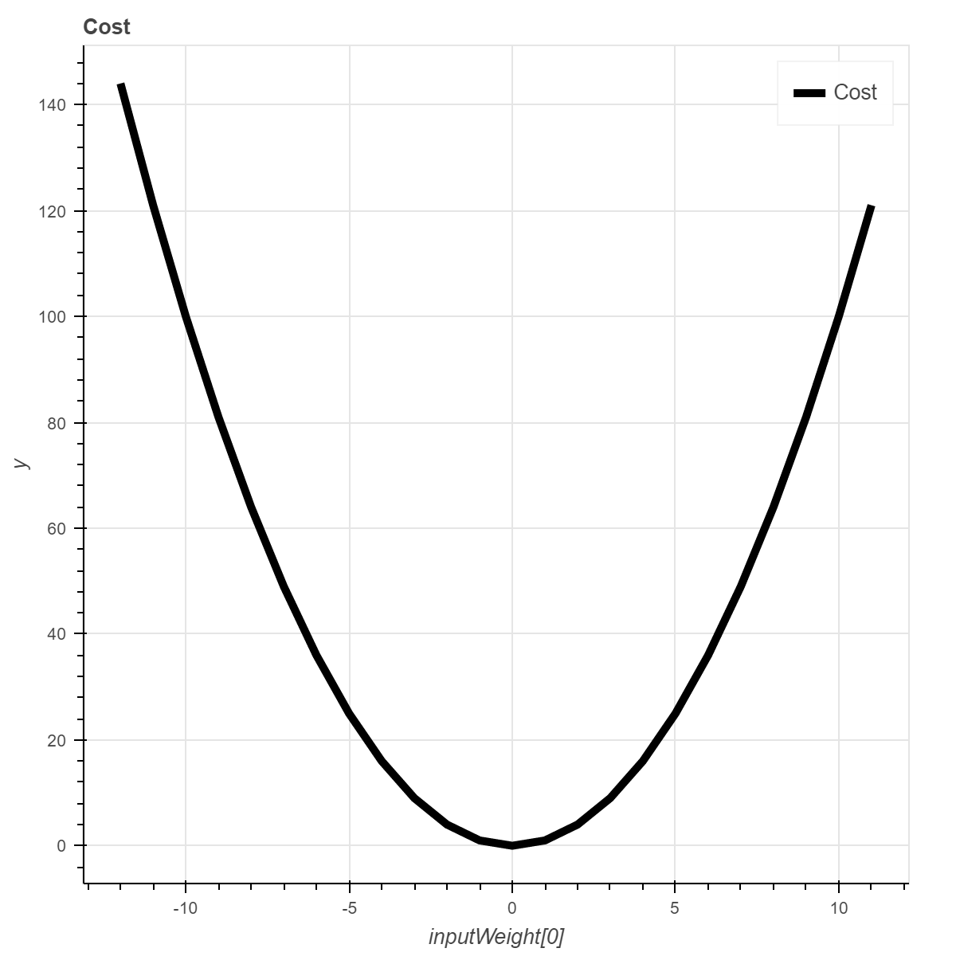


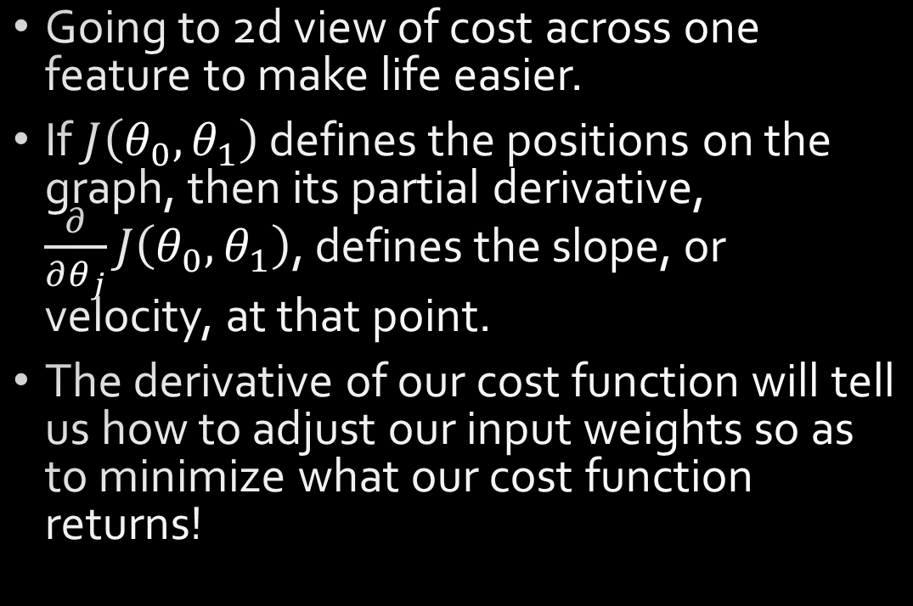
Linear Regression - adjusting our guess
Going to 2d view of cost across one feature to make life easier.
If $J\left(θ_{0},θ_{1}\right)$ defines the positions on the graph, then its partial derivative, $\frac{∂}{∂θ_{j}}J\left(θ_{0},θ_{1}\right)$, defines the slope, or velocity, at that point.
The derivative of our cost function will tell us how to adjust our input weights so as to minimize what our cost function returns!
$$J\left(−10,θ_{1}\right)$$
$$\frac{∂}{∂θ_{j}}J\left(−10,θ_{1}\right)$$

Slide 11


Linear Regression – adjusting our guess
Calculating $\frac{∂}{∂θ_{j}}J\left(θ_{0},θ_{1}\right)$ is outside our focus, so I will just give the result.
$j=0:$
$\frac{∂}{∂θ_{j}}J\left(θ_{0},θ_{1}\right)= \frac{1}{m}\sum_{i=1}^{m}{\left(h_{θ}\left(x_{i}\right) − y_{i}\right)}$
$j=1:$
$\frac{∂}{∂θ_{j}}J\left(θ_{0},θ_{1}\right)= \frac{1}{m}\sum_{i=1}^{m}{\left(h_{θ}\left(x_{i}\right) − y_{i}\right)} ∗x_{i}$
$$J\left(−10,θ_{1}\right)$$
$$\frac{∂}{∂θ_{j}}J\left(θ_{0},θ_{1}\right)$$

Slide 12
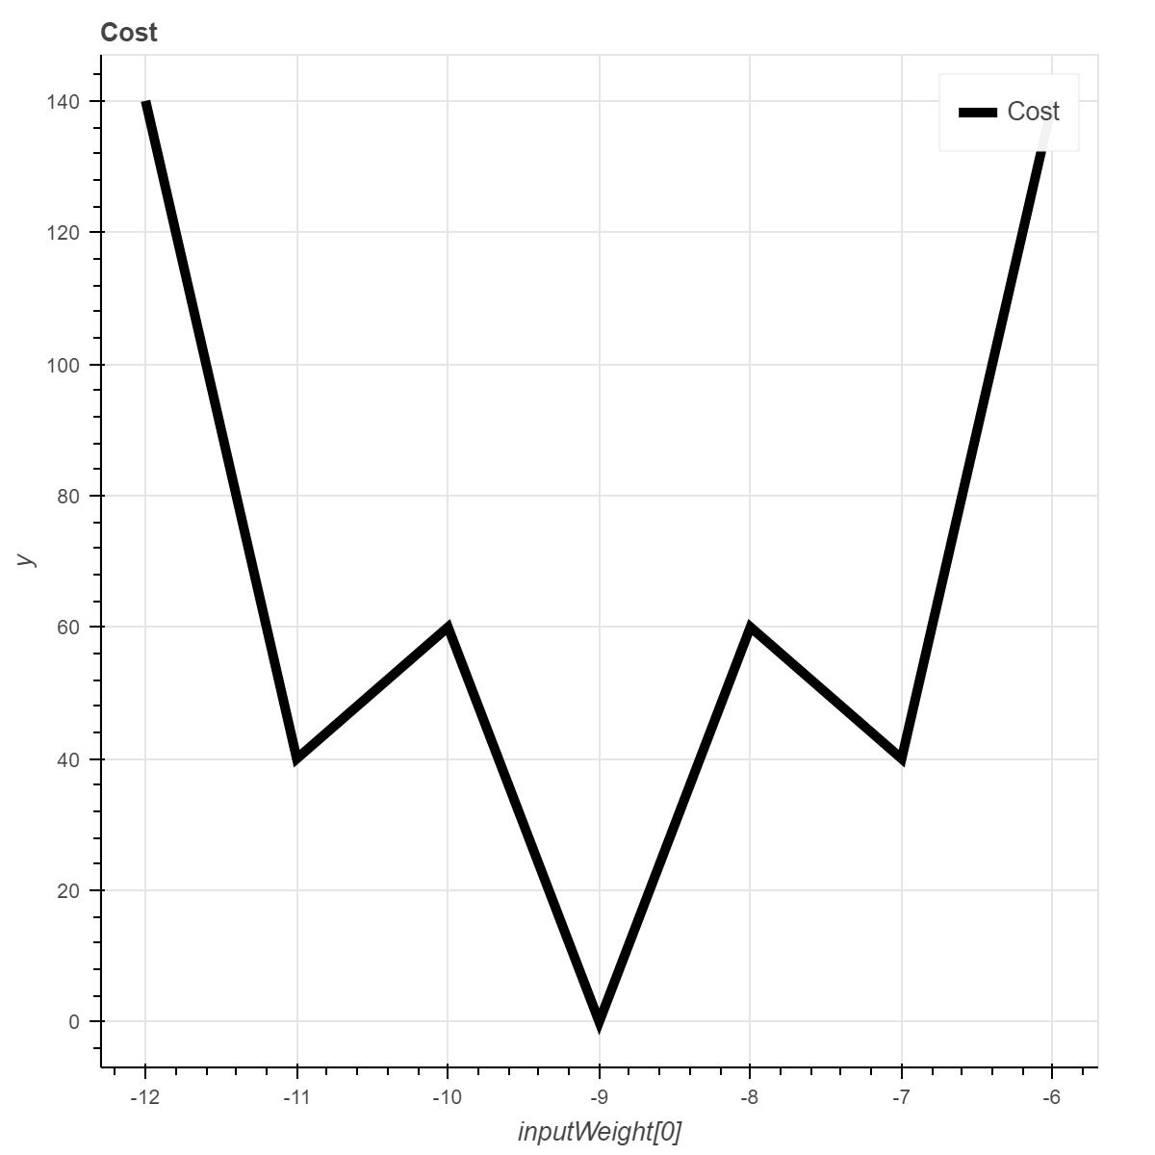
Global vs Local Minima
Many functions will have local minimums.
Luckily, our simple linear regression heuristic and cost method define a convex function where the global and local are always the same.
More complex heuristics are unlikely to produce convex results.
It is impossible to guarantee finding of the global minima of an arbitrary function.
Local
Global

Slide 13

Gradient Descent
We can use the gradient descent algorithm to iteratively adjust our input weights to find a local minimum to our cost function.
repeat until convergence:
{
for each $θ_{j}$
$θ_{j}$update = $θ_{j}−α$ $\frac{∂}{∂θ_{j}}J\left(θ_{0},θ_{1}\right)$
for each $θ_{j}$
$θ_{j}$= $θ_{j}$update
}

Slide 14
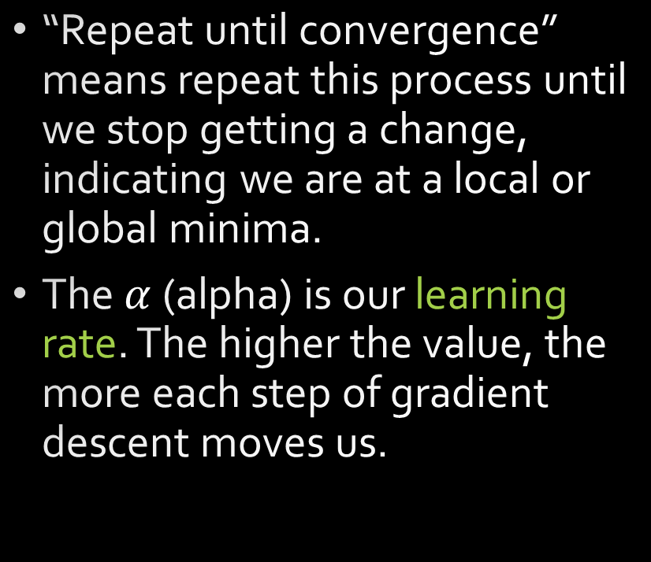

Gradient Descent
repeat until convergence
{
for each $θ_{j}$
$θ_{j}$update = $θ_{j}−α$ $\frac{∂}{∂θ_{j}}J\left(θ_{0},θ_{1}\right)$
for each $θ_{j}$
$θ_{j}$= $θ_{j}$update
}
“Repeat until convergence” means repeat this process until we stop getting a change, indicating we are at a local or global minima.
The $α$ (alpha) is our learning rate. The higher the value, the more each step of gradient descent moves us.

Slide 15
Gradient Descent
If the learning rate is very small, gradient descent will have to be run many times to get a good result.
If the learning rate is too high, it can actually jump right past the local minima and get a worse answer!
We will have to manually adjust our number of iterations and learning rate to get the best results possible.
This can of course be automated as well.

Slide 16
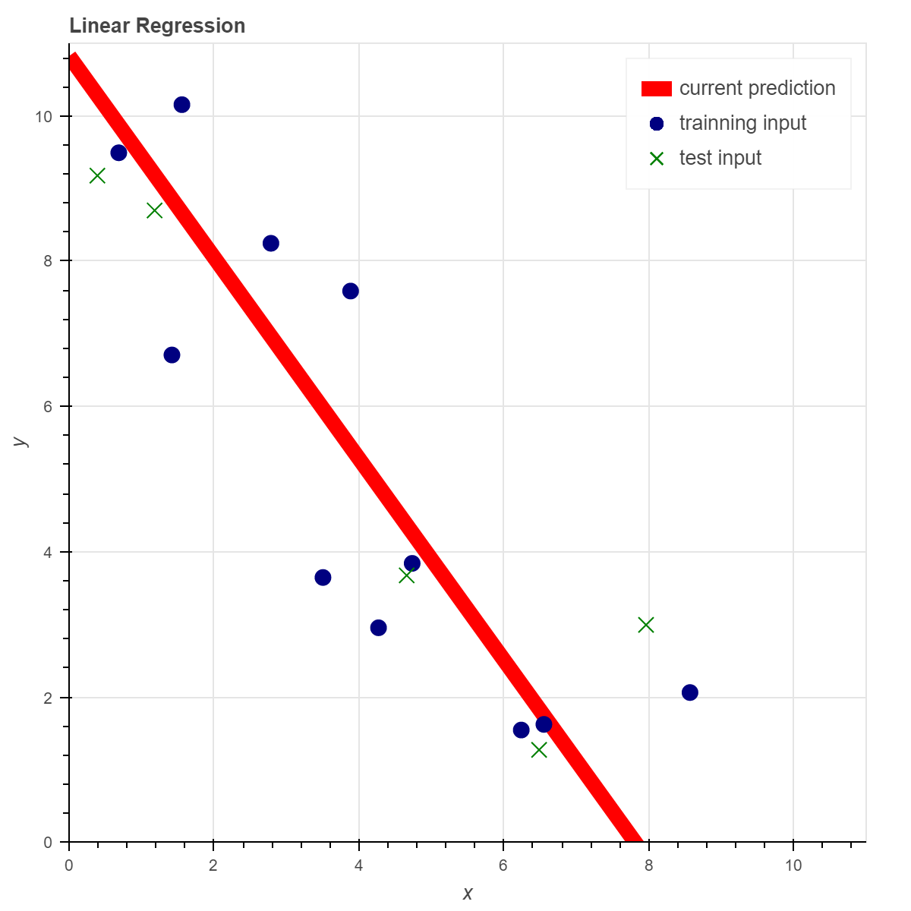
Training and testing
A portion of our data will be reserved for testing our resulting heuristic.
We will not train on this data.
We run our cost function using the test data to determine how good our heuristic will be at predicting values it was not trained on.
Commonly around 20% of data is reserved for testing.

